Slide 1
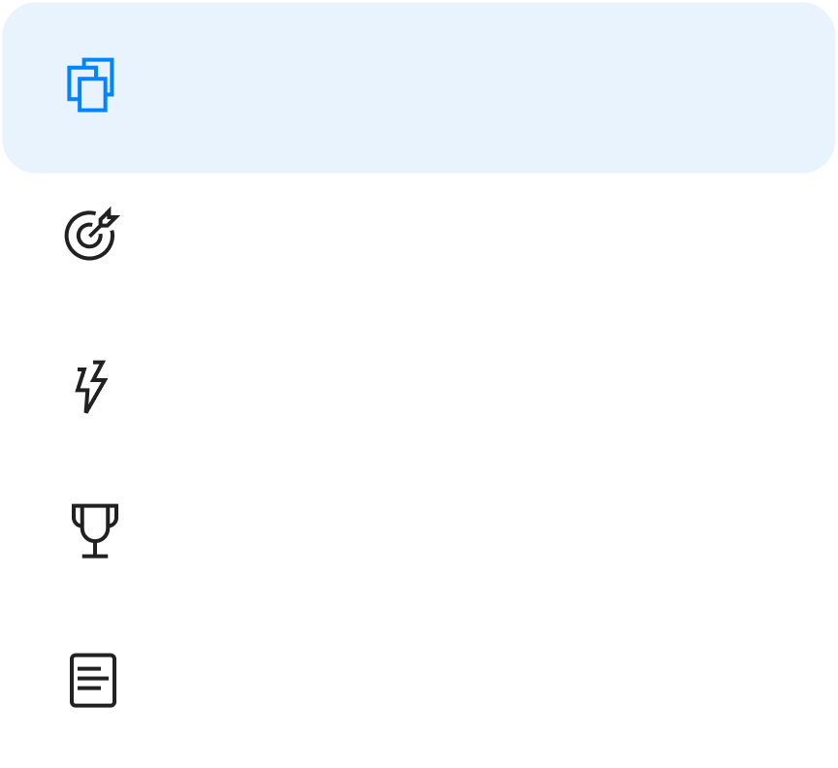
Company Overview
Categories
c | Company Overview | Brief description of your company, its main products or services, and any other valuable strategic information
Company Overview
Objectives
Key Results
Competitive Landscape
Lean Canvas

Slide 2
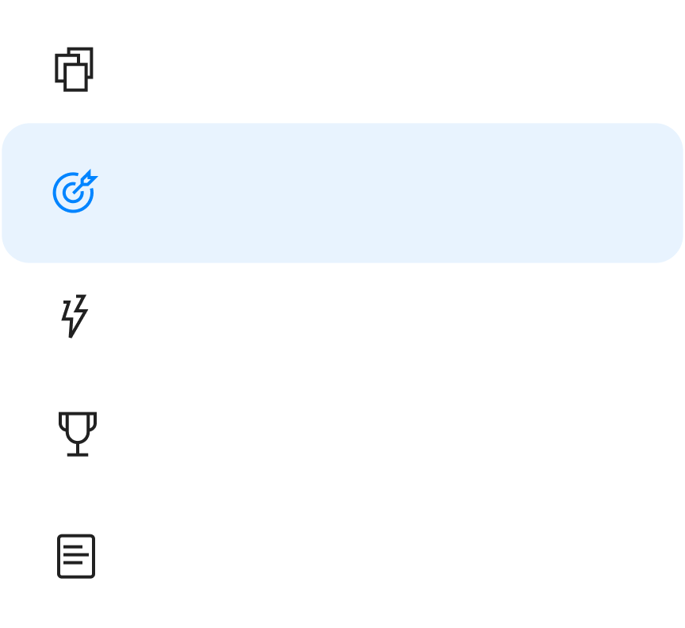
Objectives
Categories
 | Reduce churn | An Objective is a qualitative statement outlining a high level goal your product is set to achieve. These are typically intentionally broad and speak to the team’s long-term mission.
 | Objective #2 | Description
 | Objective #3 | Description
Company Overview
Objectives
Key Results
Competitive Landscape
Lean Canvas

Slide 3
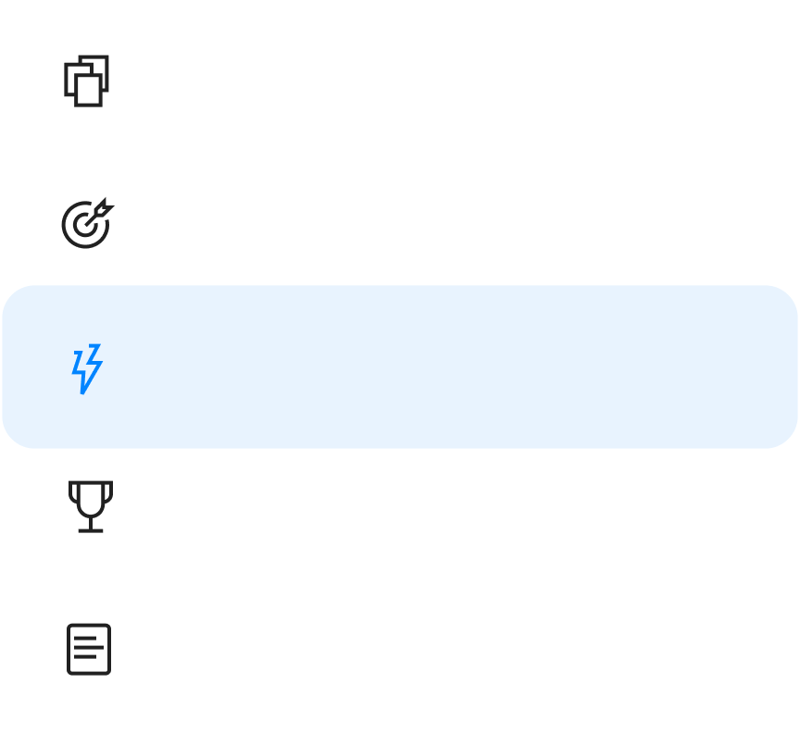
Key Results
Categories
 | Increase average deal size by 50% | Specific and actionable, Key Results reflect the actions you want to take to achieve your objective. They are usually a numerical metric for growth, performance, or engagement, but they can also represent a milestone that is done or undone.
 | Key Result #2 | Description
 | Key Result #3 | Description
Company Overview
Objectives
Key Results
Competitive Landscape
Lean Canvas

Slide 4
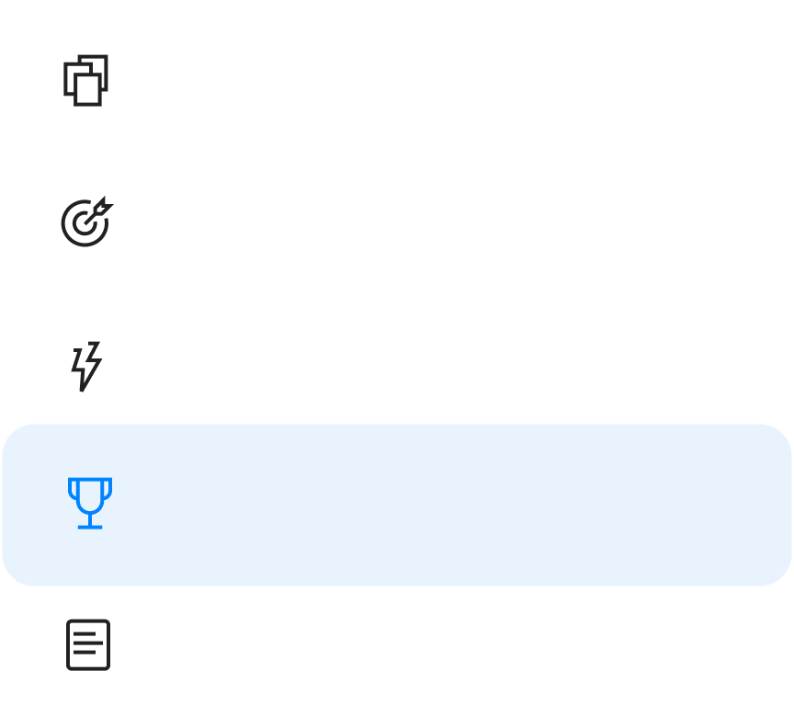
Competitive Landscape
Categories
Competitive landscape table provides an overall market outlook and helps assess your next steps for your brand and business
Company Overview
Objectives
Key Results
Overview | Founded in 2021 – Denver, Colorado | Founded in 2006 – Stockholm, Sweden, it is one of the world's largest music streaming services | Launched in 2015 – it is one of the world's leading music services
Business Model | Paid and Freemium | Paid and Freemium subscription models. Freemium subscription includes ad-monetization | Premium (paid) only
Pricing | $9.99/month | $9.99/month | $9.99/month
Strengths | Artists focused New music ownership model Web3 support | Brand recognition Extensive Music Library | Exclusive artists content IOS native
Weaknesses | New to the market | Low royalty payments for artists | No free plan
Competitive Landscape
Lean Canvas

Slide 5
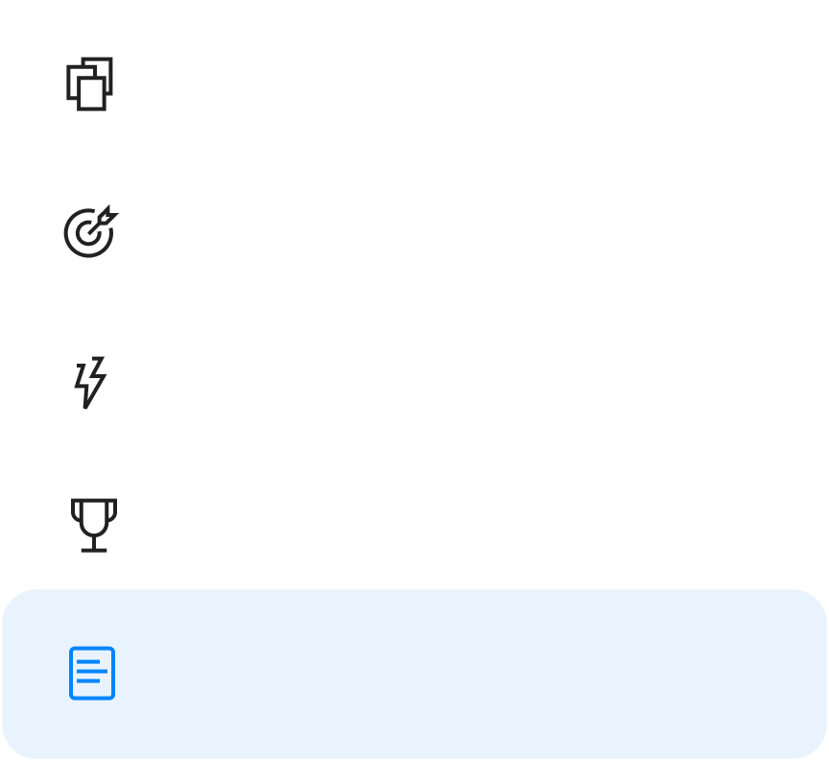
Lean Canvas
Categories
The Lean Canvas model helps deconstruct a business idea into its key assumptions. Deeply influenced by the lean methodology, the Lean Canvas servers as a tactical plan to guide a business from ideation through build.
Company Overview
Objectives
Key Results
1 - Problem Top 3 problems: 1. First 2. Second 3. Third | 4 - Solution Top 3 features | 3 - Unique Value Single clear and compelling message that states why you are different and worth buying |  | 9 - Unfair Advantage Can't be easy copied or bought | 2 - Customer Segment Target customers
Existing Alternatives List how these problems are solved today | 8 - Key Metrics Key activities to measure | High Level Concept List your X for Y analogy |  | 5 - Channels Path to customers | Early Adopters List of the characteristics of your ideal customers
7 - Cost Structure List your fixed and variable costs Customer acquisition costs Distribution costs Hosting People Etc... |  |  | 6 - Revenue Streams List your sources of revenue Revenue model Life time value Revenue Gross Margin
Competitive Landscape
Lean Canvas

